Slide 1


RESEARCH KNOWLEDGE
REPOSITORY WITH SEMANTIC
SEARCH
GROUP-4
SUPERVISOR:
MRS.MELINDA
25CS1302E
DBE & DSD
TEAM MEMBERS
2510080024- AKSHAYA
2510080022- NIHARIKA
2510080019- HARSHINI
2510080023- VARNA

Slide 2

PROJECT PROGRESS
2
Three-stage review roadmap
REVIEW 1
REVIEW 2
REVIEW 3
Problem & Objectives
Literature Survey & Research Gap
Methodology Development & Working Prototype
▪ Problem identification
▪ Objectives
▪ Proposed modules
▪ Expected outcomes
▪ Literature survey
▪ Existing approaches
▪ Research gap
▪ Proposed direction
▪ Methodology
▪ Implementation
▪ Working modules
▪ Intermediate results
▪ Evaluation
▪ Next steps
Review 3 | Methodology Development | Research Knowledge Repository with Semantic Search

Slide 3
PROBLEM STATEMENT
3
Why semantic retrieval is needed
▪ The rapid growth of machine learning research literature makes relevant papers difficult to find.
▪ Traditional keyword-based search may miss papers that use different terminology for similar concepts.
▪ Researchers need meaning-based retrieval rather than only exact keyword matching.
▪ Existing systems provide limited support for identifying relationships, trends and research gaps.
Large Research Literature
Information Overload
Difficulty Finding Relevant Papers
Need for Semantic Search
Review 3 | Methodology Development | Research Knowledge Repository with Semantic Search

Slide 4
OBJECTIVES
4
Eight objectives of the proposed system
1
Build an organized research literature repository.
2
Implement semantic search.
3
Understand the meaning and context of queries.
4
Generate text embeddings for papers and queries.
5
Retrieve papers based on semantic similarity.
6
Organize papers, abstracts, methodologies, datasets and findings.
7
Support literature review.
8
Provide a foundation for research-gap identification.
Review 3 | Methodology Development | Research Knowledge Repository with Semantic Search

Slide 5
METHODOLOGY
5
System architecture and processing workflow
USER
FLASK WEB INTERFACE
UPLOAD
SEARCH
PDF VALIDATION
QUERY EMBEDDING
TEXT EXTRACTION
VECTOR SIMILARITY
TEXT EMBEDDING
RELEVANCE RANKING
POSTGRESQL + PGVECTOR
RELEVANT RESULTS
Review 3 | Methodology Development | Research Knowledge Repository with Semantic Search

Slide 6
TECHNOLOGY STACK
6
Frameworks, libraries and models used
PYTHON
Core language
FLASK
Web framework
HTML / CSS / JAVASCRIPT
Front-end interface
POSTGRESQL
Relational database
PGVECTOR
Vector extension
SENTENCE TRANSFORMERS
Embedding library
ALL-MINILM-L6-V2
Embedding model
PYPDF
PDF text extraction
FLASK-LOGIN
Session & authentication
Embedding Dimension: 384
Review 3 | Methodology Development | Research Knowledge Repository with Semantic Search

Slide 7
MODULE IMPLEMENTATION STATUS
7
Implemented modules and future work
User Authentication
✓ Implemented
PDF Upload
✓ Implemented
PDF Validation
✓ Implemented
Text Extraction
✓ Implemented
Embedding Generation
✓ Implemented
Database Storage
✓ Implemented
Semantic Search
✓ Implemented
Similarity Search
✓ Implemented
Relevance Ranking
✓ Implemented
Repository Management
✓ Implemented
View / Download
✓ Implemented
Update / Delete
✓ Implemented
FUTURE WORK
Research Gap Detection
Recommendations
→ Future Work
Review 3 | Methodology Development | Research Knowledge Repository with Semantic Search

Slide 8
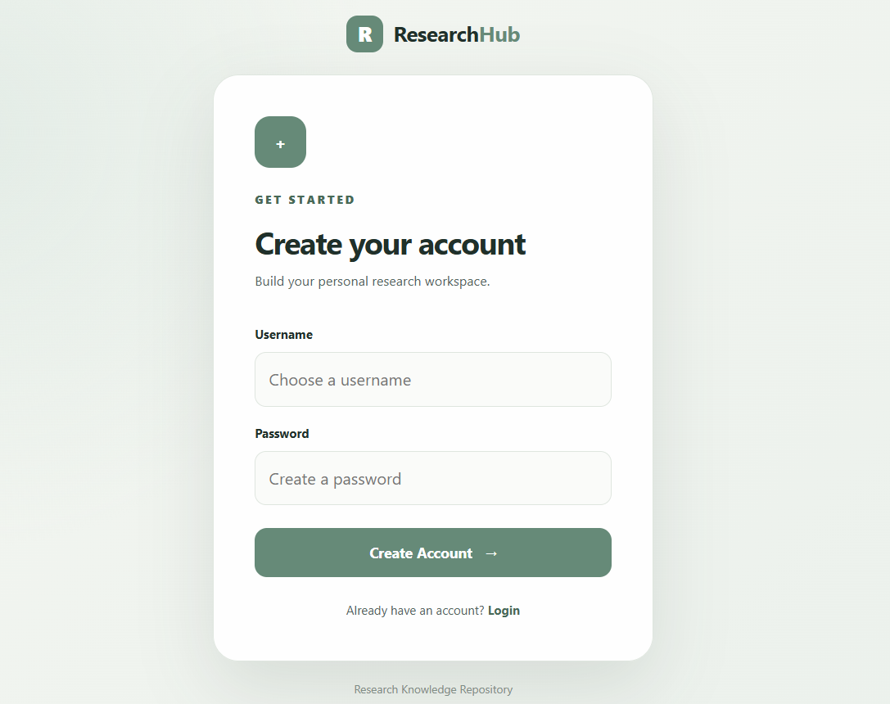
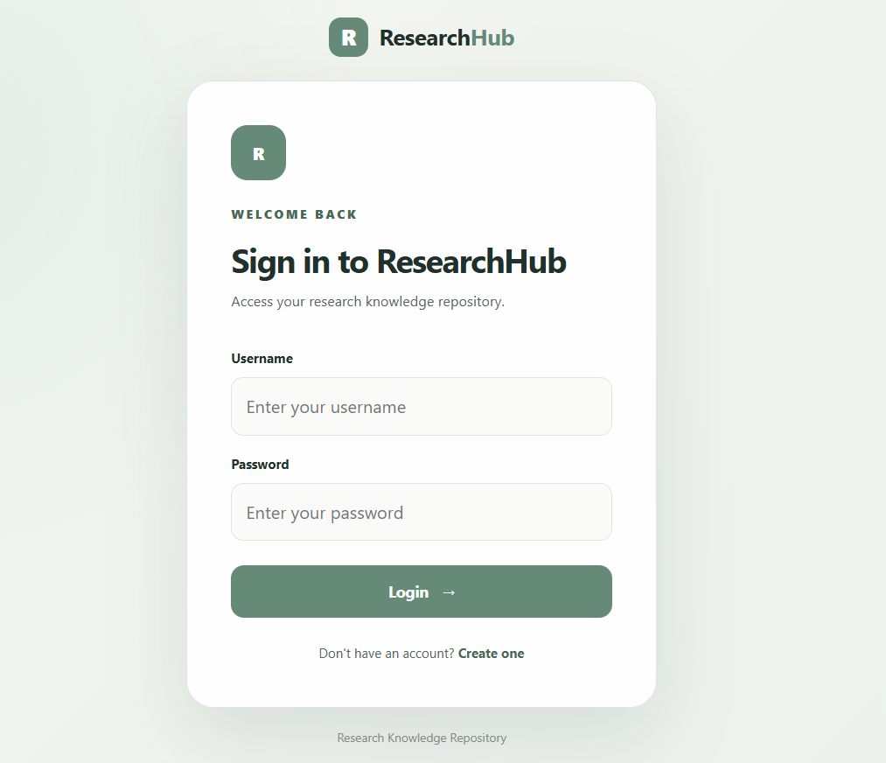
MODULE 1 – USER AUTHENTICATION
8
Secure access to the repository
▪ User registration
▪ User login
▪ Authentication using Flask-Login
▪ Protected application functionality
▪ Logout
Review 3 | Methodology Development | Research Knowledge Repository with Semantic Search

Slide 9
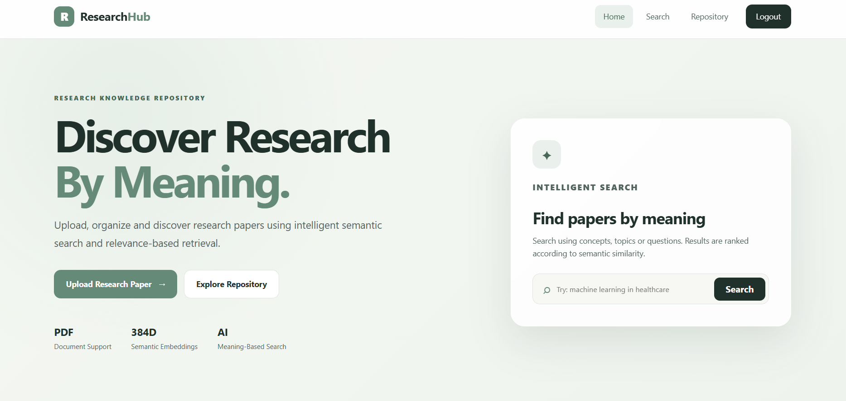
MODULE 2 – PDF UPLOAD & VALIDATION
9
Ingestion of research papers
User selects PDF
File validation
PDF saved
Text extraction initiated
▪ Research papers are uploaded in PDF format.
▪ Uploaded files are validated.
▪ Valid files are processed for text extraction.
Review 3 | Methodology Development | Research Knowledge Repository with Semantic Search

Slide 10
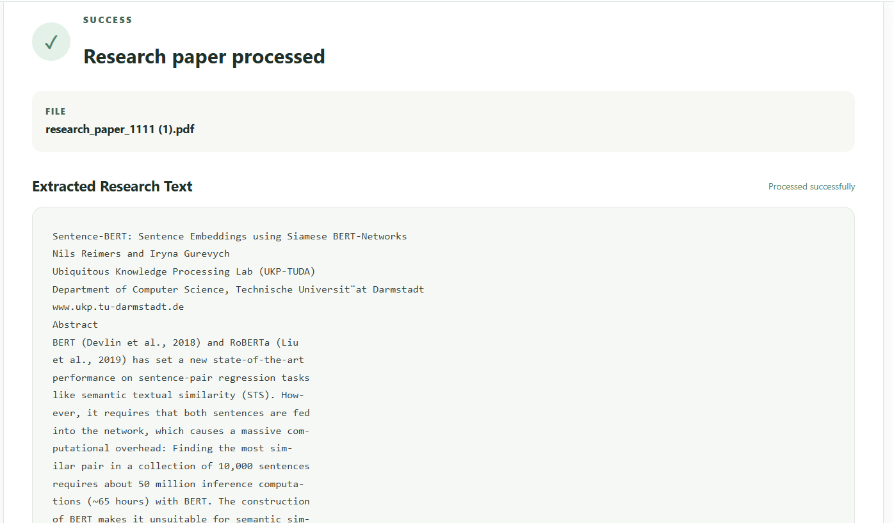
MODULE 3 – TEXT EXTRACTION
10
PDF content to processable text
PDF
PyPDF
Extracted Text
Text Processing
Embedding Generation
▪ PDF content is extracted using PyPDF.
▪ Extracted text is used for semantic representation.
▪ Extracted text is stored in PostgreSQL.
Review 3 | Methodology Development | Research Knowledge Repository with Semantic Search

Slide 11
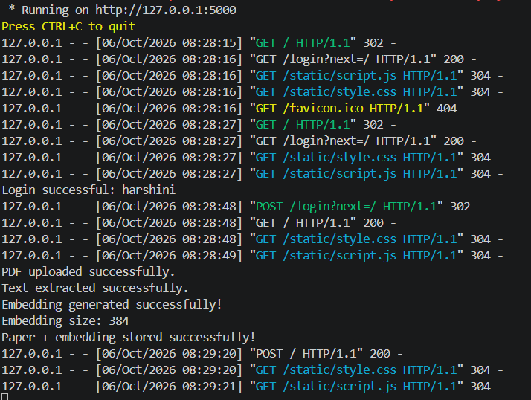
MODULE 4 – EMBEDDING GENERATION
11
Semantic vector representation of research papers
Research Paper Text
Sentence Transformer
all-MiniLM-L6-v2
384-Dimensional Vector
▪ Sentence Transformers are used for semantic representation.
▪ Model: all-MiniLM-L6-v2
▪ Embedding dimension: 384
▪ Both research papers and search queries are converted into vectors.
Review 3 | Methodology Development | Research Knowledge Repository with Semantic Search

Slide 12
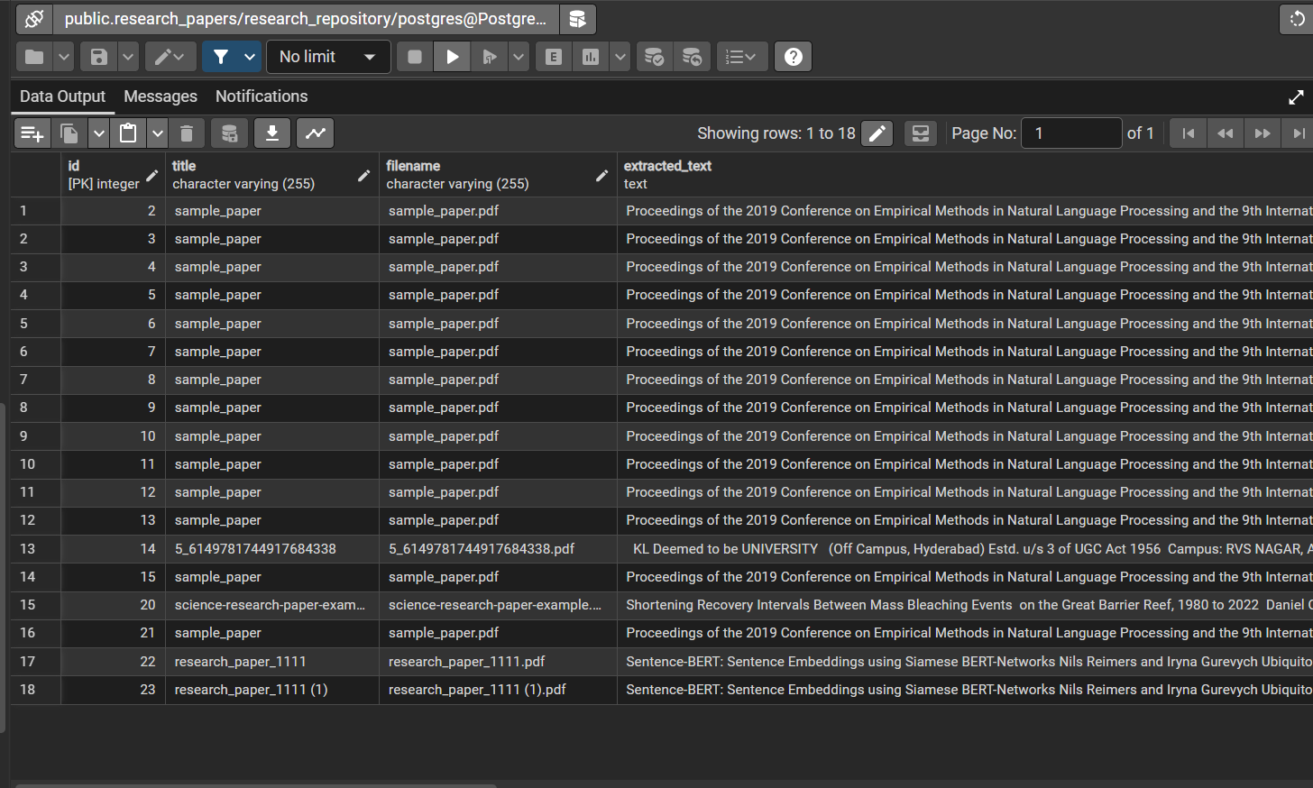
MODULE 5 – DATABASE & VECTOR STORAGE
12
Metadata, text and vector persistence
PostgreSQL + pgvector
Table: research_papers
research_papers
id
title
filename
extracted_text
uploaded_at
embedding
▪ PostgreSQL stores research-paper metadata and extracted text.
▪ pgvector stores 384-dimensional embeddings.
▪ Vector data enables similarity-based retrieval.
Review 3 | Methodology Development | Research Knowledge Repository with Semantic Search

Slide 13
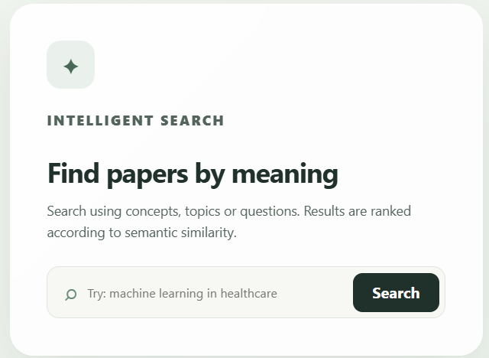
MODULE 6 – SEMANTIC SEARCH
13
Meaning-based retrieval pipeline
USER QUERY
▪ Search queries are converted into embeddings.
▪ Query embeddings are compared with stored paper embeddings.
▪ Similar papers are retrieved using vector similarity.
▪ Results are ranked by relevance.
QUERY EMBEDDING
384-D VECTOR
PGVECTOR SIMILARITY SEARCH
RELEVANCE RANKING
SEARCH RESULTS
Review 3 | Methodology Development | Research Knowledge Repository with Semantic Search

Slide 14
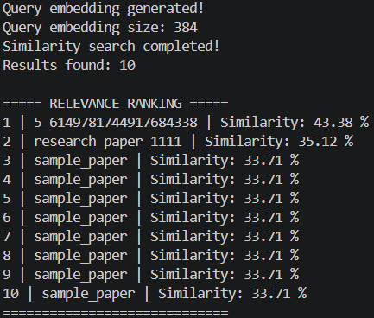
MODULE 7 – SIMILARITY SEARCH & RANKING
14
Cosine-distance retrieval over stored vectors
▪ Query embedding is generated.
▪ Stored research-paper embeddings are compared with the query.
▪ pgvector performs cosine-distance based similarity search.
▪ Results are ordered by semantic relevance.
▪ Top relevant papers are returned.
Query Vector
Cosine Similarity
Similarity Scores
Ranking
Top Relevant Papers
Review 3 | Methodology Development | Research Knowledge Repository with Semantic Search

Slide 15
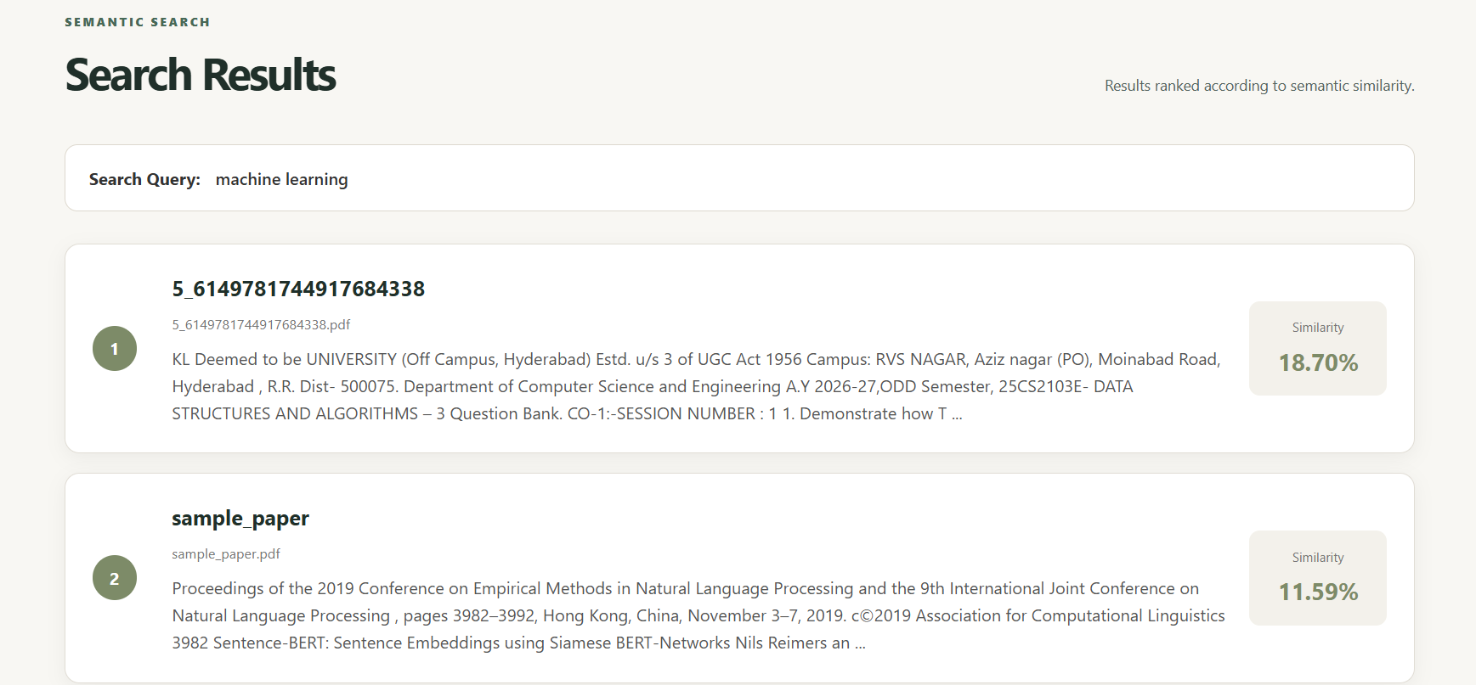
INTERMEDIATE RESULT – SEMANTIC SEARCH
15
Working prototype output
▪ Search returns semantically relevant research papers.
▪ Results are ranked according to similarity.
▪ Users can access relevant papers from the repository.
Review 3 | Methodology Development | Research Knowledge Repository with Semantic Search

Slide 16
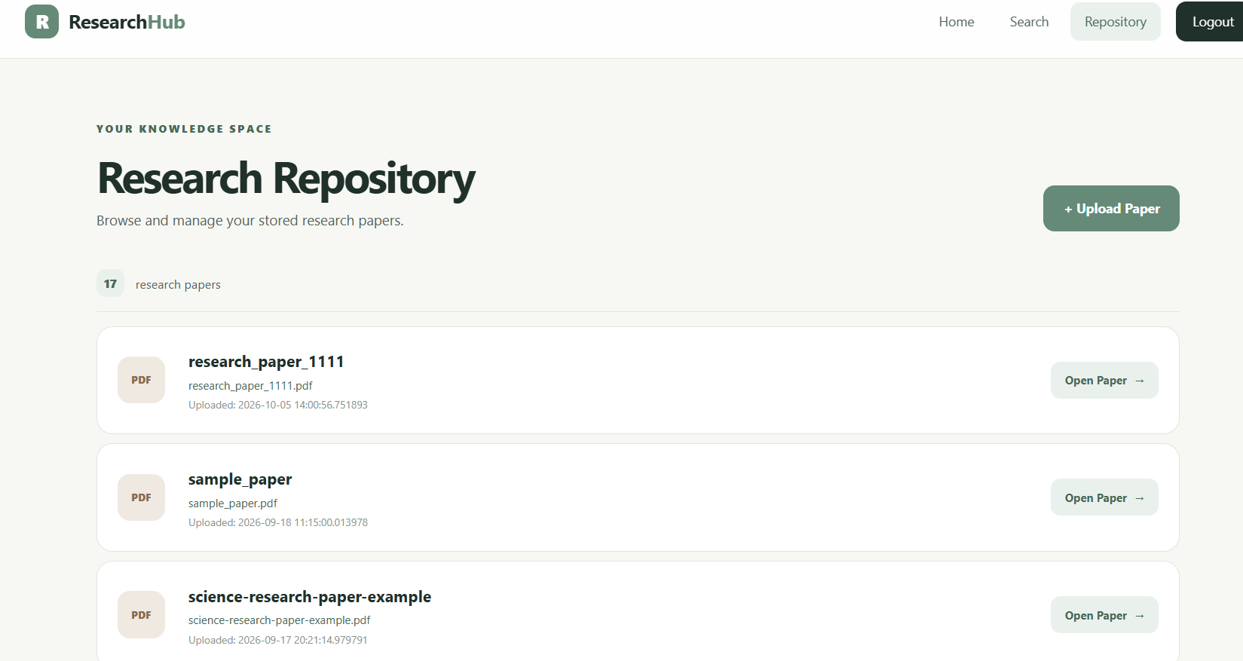
MODULE 8 – RESEARCH REPOSITORY
16
Central access point to stored papers
The repository provides:
View paper
Download paper
Update paper
Delete paper
Review 3 | Methodology Development | Research Knowledge Repository with Semantic Search

Slide 17
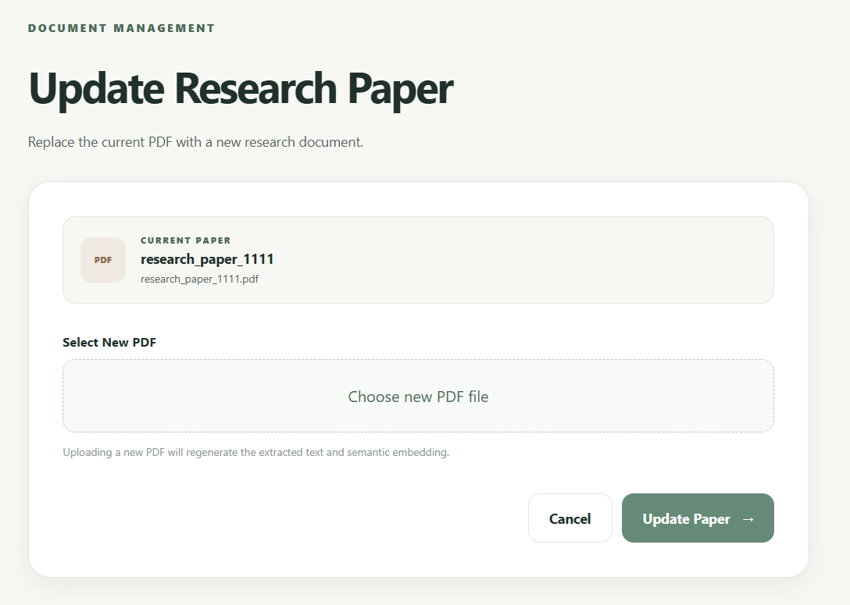
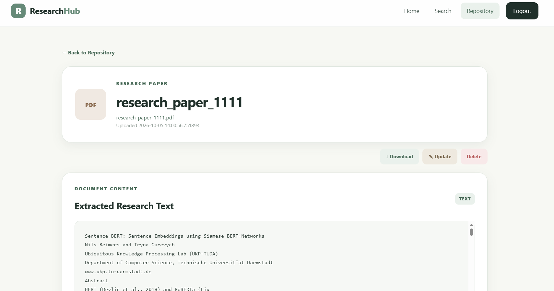
PAPER MANAGEMENT OPERATIONS
17
Managing uploaded papers through the interface
VIEW
DOWNLOAD
UPDATE
DELETE
Uploaded papers can be managed through the repository interface.
Review 3 | Methodology Development | Research Knowledge Repository with Semantic Search

Slide 18
INTERMEDIATE RESULTS
18
Functional status of the working prototype
✓
Registration Working
✓
Login Working
✓
PDF Upload Working
✓
PDF Extraction Working
✓
384-D Embedding Generation Working
✓
PostgreSQL Storage Working
✓
pgvector Search Working
✓
Semantic Search Working
✓
Relevance Ranking Working
✓
Repository Working
✓
View / Download Working
✓
Update / Delete Working
Status indicates functional verification of each module; no accuracy or performance values are claimed at this stage.
Review 3 | Methodology Development | Research Knowledge Repository with Semantic Search

Slide 19
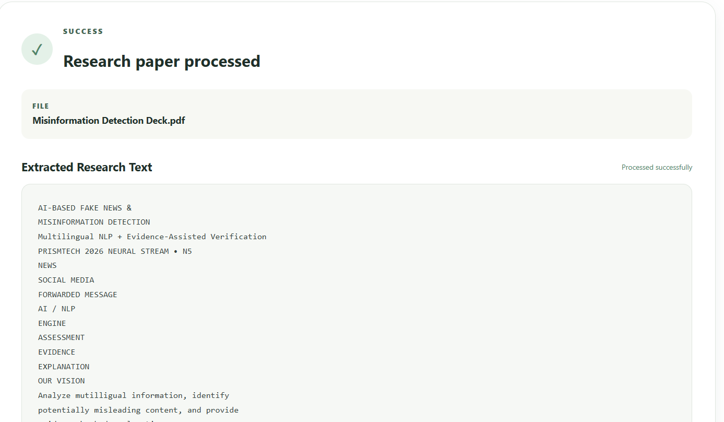
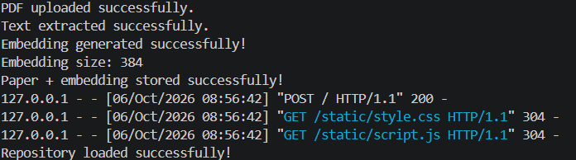
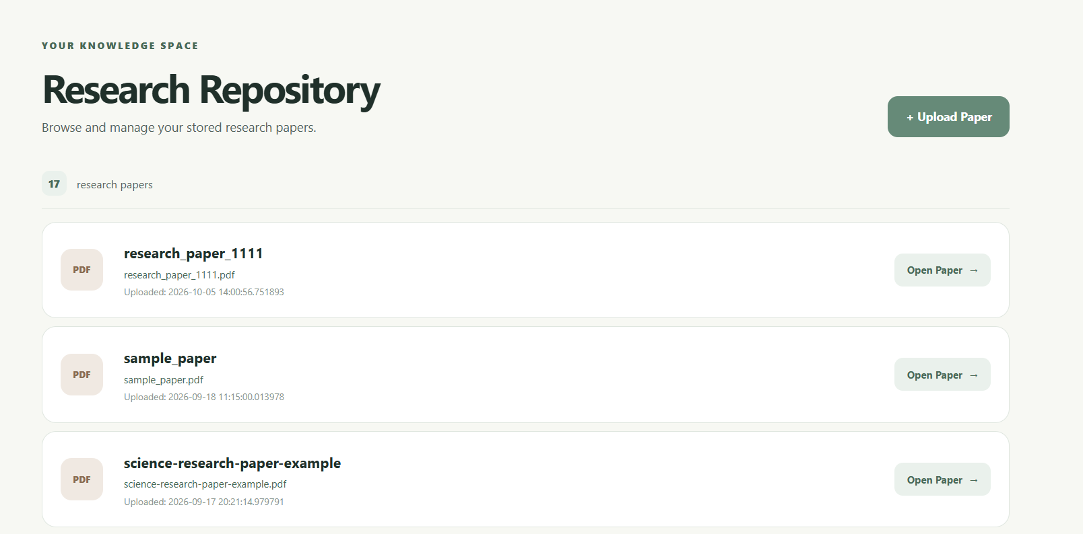
IMPLEMENTATION EVIDENCE
19
Screenshots of working modules
384-dimensional embedding output
PDF upload confirmation
Semantic search results
Repository management page

Slide 20
CURRENT EVALUATION
20
Preliminary and functional validation
Evaluation at Review 3 is preliminary and functional. The focus is on verifying that each module operates as intended.
CURRENT VALIDATION
FUTURE QUANTITATIVE EVALUATION
▪ Authentication tested
▪ PDF upload tested
▪ Text extraction tested
▪ 384-dimensional embeddings verified
▪ Database storage verified
▪ Semantic search tested
▪ Similarity ranking verified
▪ Repository operations tested
→ Precision@K
→ Recall@K
→ Top-K relevance
→ Keyword vs semantic search comparison
→ Search response time
→ Larger dataset evaluation
Review 3 | Methodology Development | Research Knowledge Repository with Semantic Search

Slide 21
NOVELTY OF THE APPROACH
21
Meaning-based retrieval versus keyword matching
TRADITIONAL SEARCH
PROPOSED APPROACH
Query
Query
Query Embedding
Keyword Matching
Semantic Similarity
Ranking
Results
Relevant Research Papers
“The system integrates semantic vector retrieval with a research-paper repository, enabling meaning-based retrieval rather than relying only on exact keyword matching.”
Review 3 | Methodology Development | Research Knowledge Repository with Semantic Search

Slide 22
ADAPTABILITY & FUTURE EXTENSIONS
22
An expandable system design
CURRENT SYSTEM
Larger Research Dataset
Different Embedding Models
Metadata Filtering
Citation Analysis
Paper Summarization
Each extension builds on the same repository and embedding pipeline.
Question Answering
Research Recommendations
Research Gap Detection
Review 3 | Methodology Development | Research Knowledge Repository with Semantic Search

Slide 23
CURRENT LIMITATIONS
23
Scope of the Review 3 prototype
Current research-paper dataset is limited.
Search evaluation is preliminary.
Quantitative evaluation is pending.
Research-gap detection is not yet implemented.
Recommendation functionality is not yet implemented.
Large-scale performance has not yet been evaluated.
These limitations confirm that the presentation reflects a Review 3 progress stage rather than a final project.

Slide 24
NEXT STEPS
24
Roadmap from prototype to final system
WORKING PROTOTYPE
QUANTITATIVE EVALUATION
RESEARCH GAP DETECTION
FINAL SYSTEM
Core modules implemented
Precision@K, Recall@K
Identify under-explored areas
Complete evaluated system
1
2
3
4
5
6
7
LARGER DATASET
KEYWORD vs SEMANTIC COMPARISON
RECOMMENDATIONS
More research papers
Retrieval quality comparison
Suggest related papers
Review 3 | Methodology Development | Research Knowledge Repository with Semantic Search

Slide 25
CONCLUSION
25
“The project has progressed from the planning and literature-review stage to a working prototype. The core modules including authentication, PDF processing, text extraction, embedding generation, PostgreSQL/pgvector storage, semantic search, relevance ranking and repository management have been implemented and tested. The next phase will focus on systematic evaluation, larger-scale testing, research-gap analysis and further system enhancement.”

Slide 26
REFERENCES
26
1.
Devlin, J. et al. – BERT: Pre-training of Deep Bidirectional Transformers for Language Understanding.
2.
Reimers, N. & Gurevych, I. – Sentence-BERT: Sentence Embeddings using Siamese BERT-Networks.
3.
Lewis, P. et al. – Retrieval-Augmented Generation for Knowledge-Intensive NLP Tasks.
4.
Vaswani, A. et al. – Attention Is All You Need.

